Slide 1

Problem Solving Session
The remainder of today’s class will comprise the problem solving session (PSS).
Your instructor will divide you into teams of 3 or 4 students.
Each team will work together to solve the following problems over the course of 20-30 minutes.
You may work on paper, a white board, or digitally as determined by your instructor.
You will submit your solution by pushing it to GitHub before the end of class.
Your instructor will go over the solution before the end of class.
If there is any time remaining, you will begin work on your homework assignment.
Class participation is a significant part of your grade (20%). This includes in class activities and the problem solving session.
Your Course Assistants will grade your participation by verifying that you pushed your solutions before the end of the class period each day.

Slide 2

Problem Solving Team Members
Logan Costa
Lukas May
Xander Tomaszewski
Ben Eggers
Record the name of each of your problem solving team members here.
Do not forget to add every team member’s name! Your instructor (or course assistant) may or may not use this to determine whether or not you participated in the problem solving session.

Slide 3
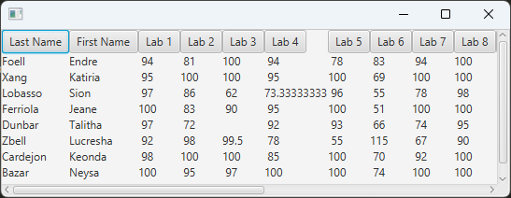
Filters
You have been provided with a GUI that will read data from a comma separated file and display it as a table using JavaFX.
One of the goals of the assignment is to use the buttons to sort that columns in ascending order. To achieve this, you will need to sort the entire data set for a specific column.
The data is already stored as a List of String arrays. For example to sort by "Last Name" you would use column index 0.
Given this information, complete the Comparator on the right so that it will sort the data by "First Name".
private List<String[]> data;
public class FirstNameComparator implements
Comparator <String[]> {
@Override
public int compare(String[] o1, String[] o2) {
return o1[1].compareTo(o2[1]);
}
}

Slide 4
EventHandler Lambdas
public FirstNameHandler implements
EventHandler <ActionEvent> {
public void handle(ActionEvent e) {
System.out.println("First Name button
pressed");
}
}
Currently the buttons in the header do nothing. Using the code on the upper right as an example, update the code in the lower right to create an EventHandler for the button as a lambda function.
To be clear, you should not call the handle function or create a FirstNameHandler. Instead, recreate the same functionality as a lambda expression.
...
Button button = new Button("First Name");
button.setOnAction (e -> System.out.println("First Name button
pressed");
);

Slide 5
Streams
// Get the header
String line = fin.readLine();
line = fin.readline(); // First data row
while (line != null) {
String[] record = line.strip().split(",");
// Store all the data in a list
data.add(record);
line = fin.readLine();
}
Currently the UI uses the code on the upper right to generate the data structure.
BufferedReader has a lines method that returns the reader as a stream of strings. Using this information refactor the provided code to use a stream to create/fill in the data list.
Some stream operations you might find helpful are:
Stream.foreach(action) - performs the specified action on each element in a stream.
Stream.collect(Collectors.toList()) - adds each element in the stream to a collection and returns it as a list
Stream.map(mapper) - applies the mapper ‘function’ to each element in a stream
Note: It is not possible to use all of the above and you are welcome to use other Stream methods discussed in class.
String line = fin.readLine();
Line = fin.readline();
fin.lines().forEach(line -> {
String[] record =
line.strip().split(",");
data.add(record);
});

Slide 6
Make It Pretty
-Round the decimal of grade numbers
-Separate the rows with borders
-If there is no grade put either a zero or a -
-Shade columns a little different so it is easier to tell which column data is in
-Change the font
Currently the UI is fairly sloppy looking. In the box to the left, describe the changes you would perform to make the displayed data look more "professional".
You do not need to write code, simply list the changes you would make.

